Slide 1
Optimizing Traffic Flow w/ ABM
By: Liam Mackay

Slide 2
What parameters does a traffic model have?
Environment
Max Velocity
Road Length
Lane Count
Vehicle Count
Weather
Agents
Prob. of Braking
Prob. of Lane-Changes
Direction
Destination

Slide 4


Some Existing Models
Nagel-Schreckenberg
Biham-Middletone-Levine

Slide 5
Fukui-Ishibashi: Basic Overview
Update Rule:
Accelerate to v_max
Stochastic Lane-Change
Reduce velocity if needed
Stochastic Slowdown
Move Forwards
Boundary Conditions
Major Differences:
Acceleration rule
Multiple Lanes
Slowdown to gap-1

Slide 6
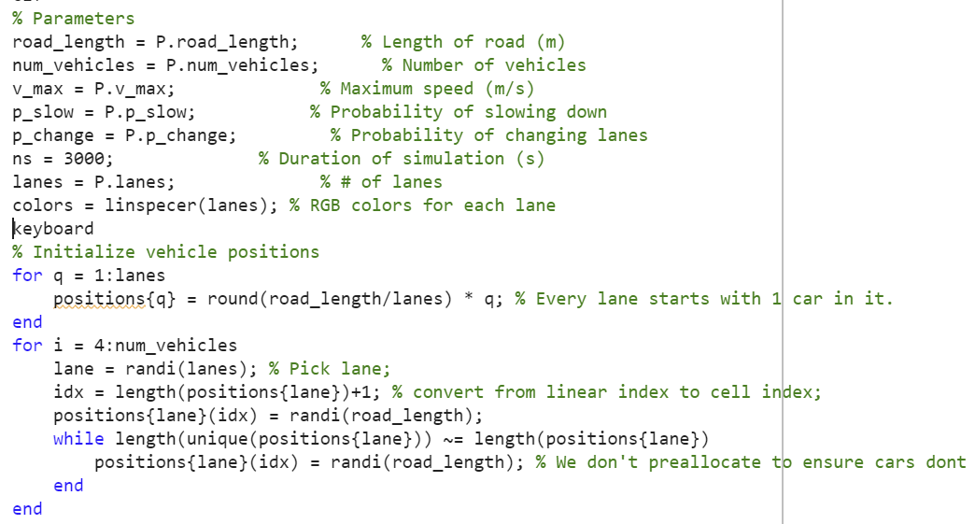
Initialization

Slide 7
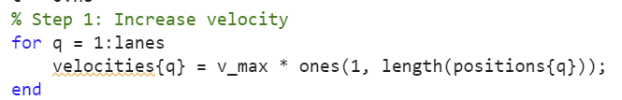
Step 1: Accelerate

Slide 8
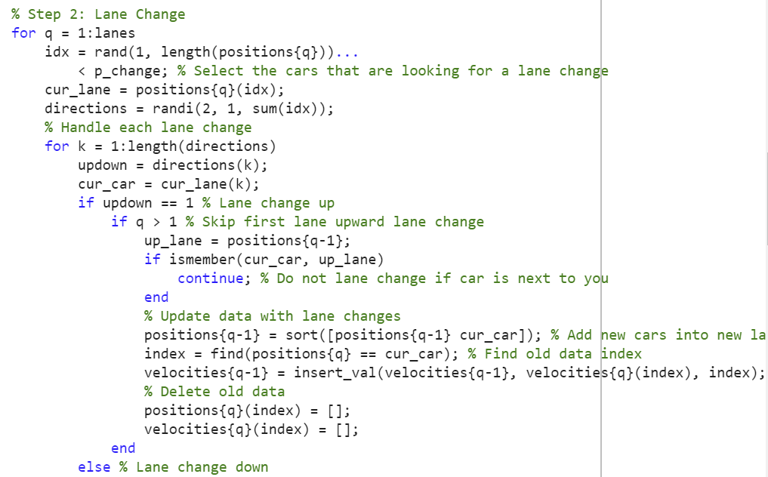
Step 2: Lane Changes

Slide 9
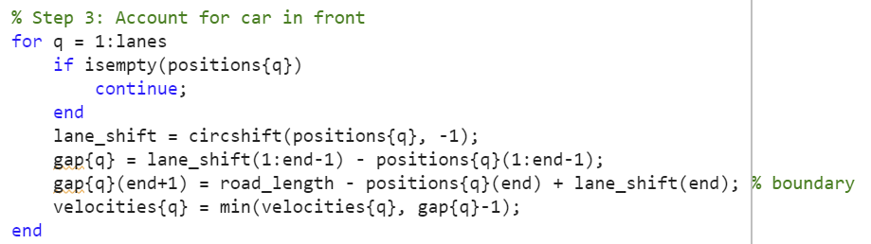
Step 3: Brake If Needed

Slide 10
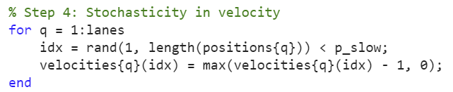
Step 4: Random Slowdowns

Slide 11
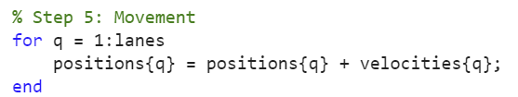
Step 5: Move

Slide 12
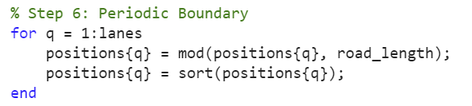
Step 6: Handle Boundary

Slide 13
Equivalent Starting Conditions

Slide 14
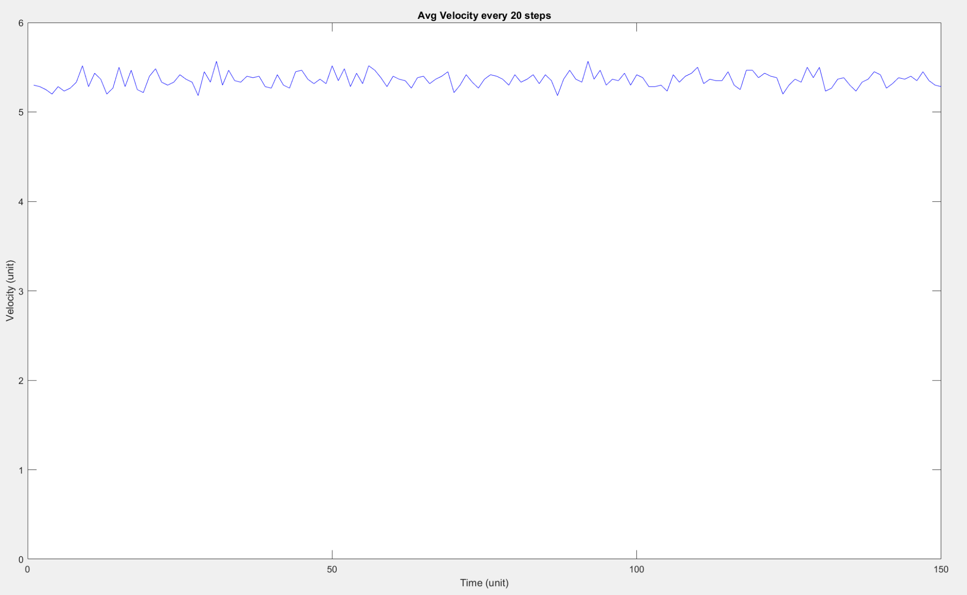

Slide 15
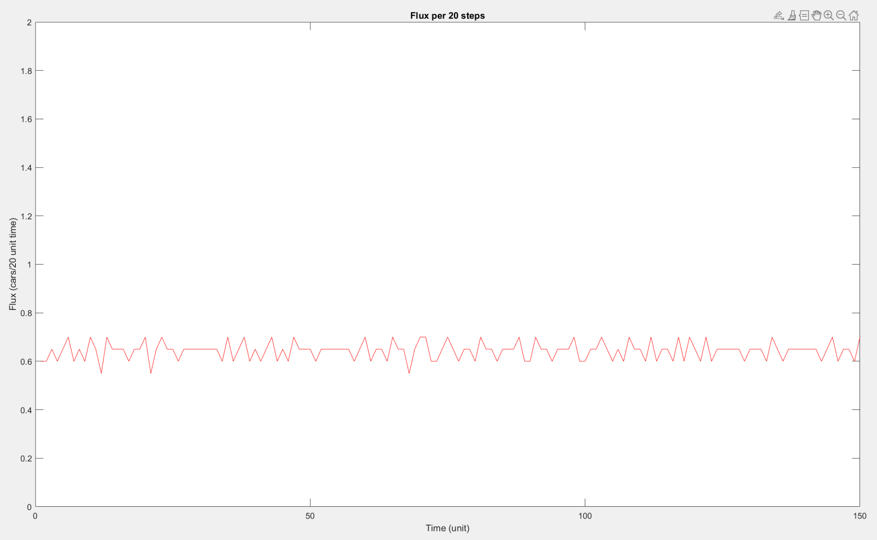

Slide 16

‘Default’ Parameters

Slide 17
High Lane Change Chance

Slide 18
High Density of Cars

Slide 19
Real-Life Situation:
Rain, so drivers are more likely to brake
Less likely to change lanes
3-lane highway
Rush hour so high car density

Slide 20

Simulation:

Slide 21
Sunny Day!

Slide 22
Improvements
Why do agents lane change?
On/Off ramps
Concrete Agent destinations
Larger/More complex road networks
Tolls

Slide 23
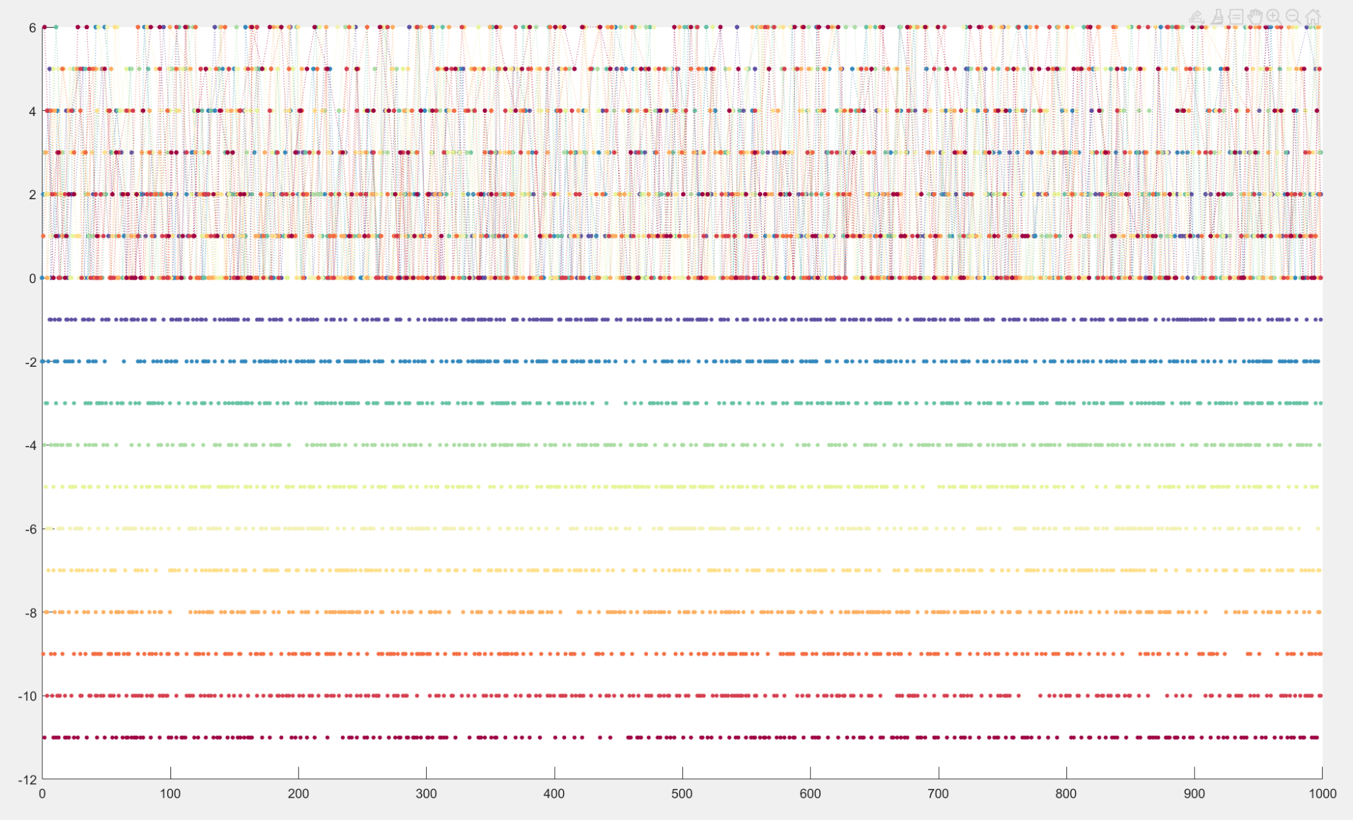
Difficulties
LANE CHANGING!!!!
Metrics
Fitting “reality”

Slide 25
Q&A

Slide 26
References
https://www.sciencedirect.com/science/article/abs/pii/S0378437119309276
https://iopscience.iop.org/article/10.1088/0305-4470/35/47/303/meta
https://www.youtube.com/watch?v=DmrmtYLabrI
https://journals.aps.org/pre/pdf/10.1103/PhysRevE.79.056108
https://reader.elsevier.com/reader/sd/pii/S0378437117312438?token=DA05088F382D407941D96EB2E2867A8B06627EE3427403D2D074881763C096BECBF0F835DE65C3666D4973B86703261A&originRegion=us-east-1&originCreation=20230426221934

